Slide 1
Developing a Medical LLM Chatbot for Personalized Mental Healthcare
Group 12: Avni Singh (R24AB0001), Gourav Sen (M24CSA011), Ankita Sarkar (P24AI0001)
GitHub Link:

Slide 2
OBJECTIVES
1. Provide Accurate Mental Health Information
2. Enable Personalized Mental Health Support
3. Leverage Retrieval-Augmented Generation (RAG)
4. Maintain Privacy and Security
5. Improve Accessibility to Mental Healthcare
6. Support Mental Health Awareness and Education
7. Enhance Engagement and User Trust

Slide 3
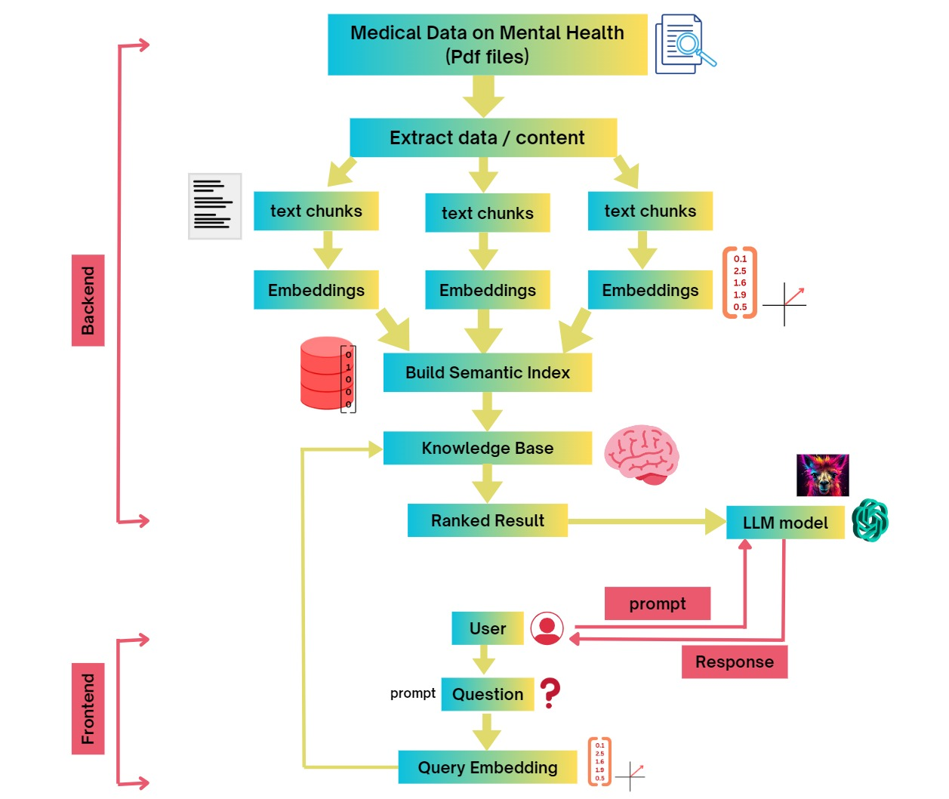
METHODOLOGY
DATASETS USED
Encyclopedia of Mental Health (Vol I, II) 2nd Edition - August 26, 2015, Editor: Howard S. Friedman
solomonk/reddit_mental_health_posts
ZahrizhalAli/mental_health_conversational_dataset
LLM USED
OpenAI GPT v2

Slide 4
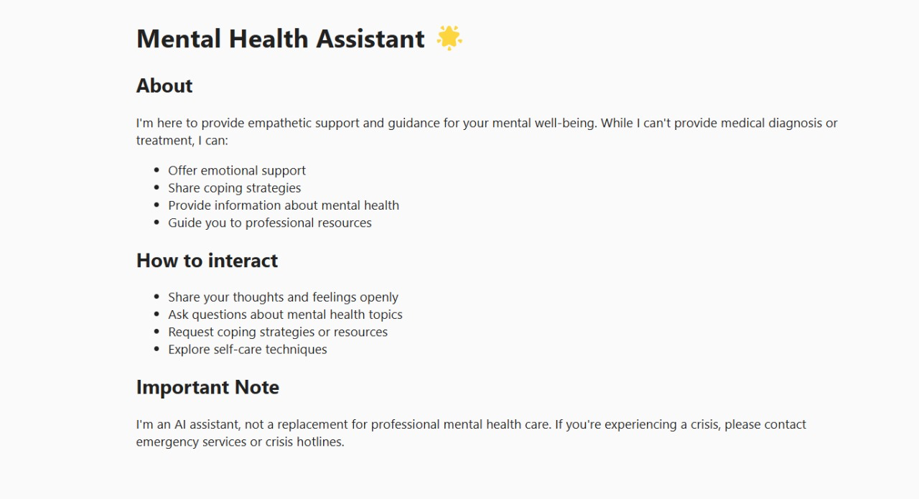
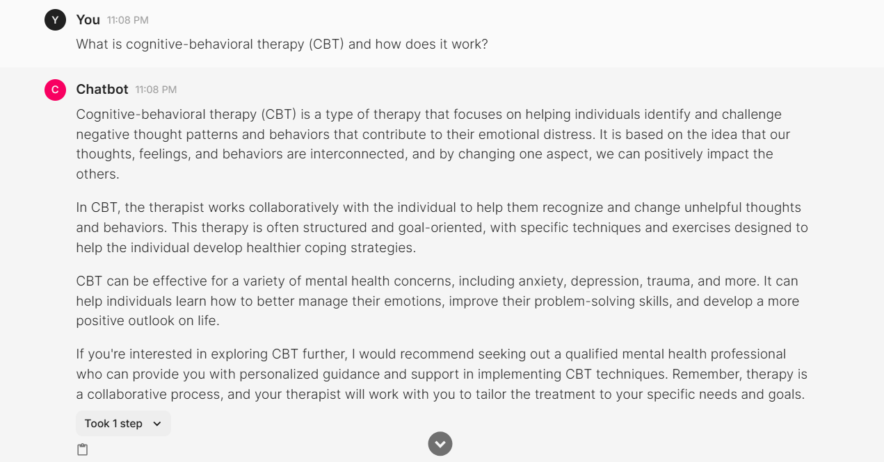
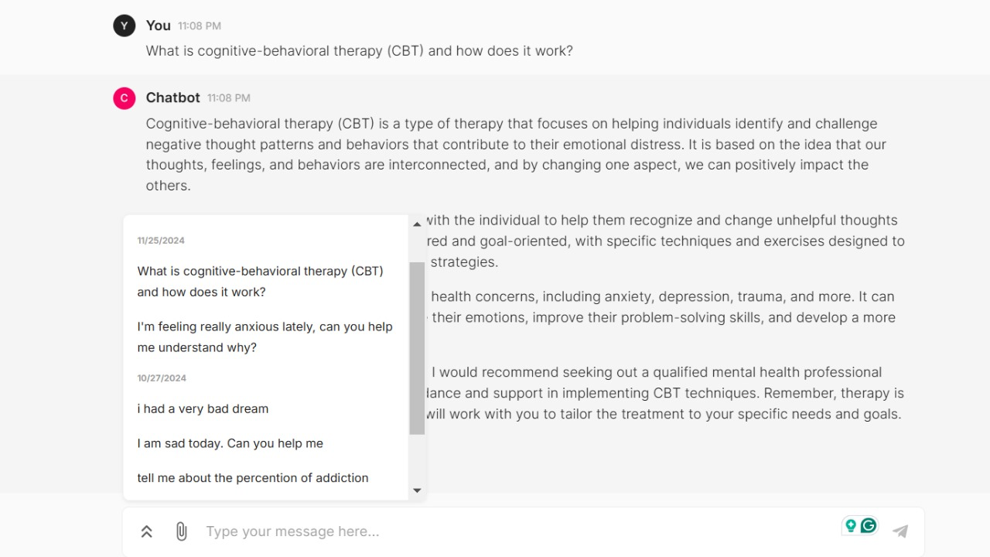
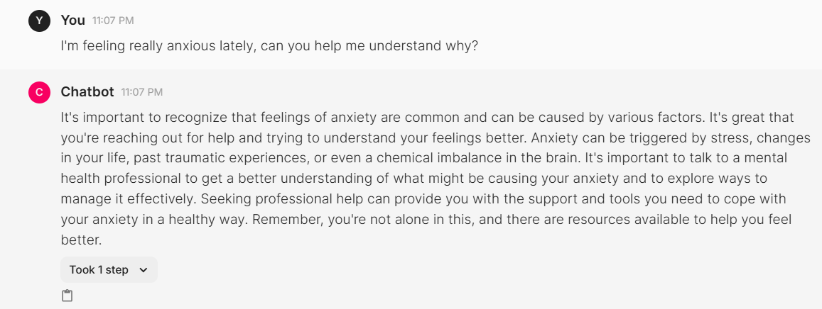
RESULTS and FEATURES
Fig 1: Interface start page for our Chatbot
Fig 2: An example of a response generated by the Chatbot on asking a Mental Health Query
Fig 3: Another example of a response generated by the Chatbot on asking a Mental Health Query
Fig 4: The dialogue box on the left displays the history of the queries, allowing the user to revisit previous conversations easily.

Slide 5
FUTURE SCOPE
EVALUATION METRICS
Jaccard Similarity (0.13) is Low. This indicates a low overlap between the unique words (or tokens) in the generated responses and the reference responses. The generated responses diverge significantly from the expected ones.
Future exploration of evaluation metrics is essential to gain deeper insights into the nuances and performance of the chatbot.

